Slide 1
Hotel Booking Cancellation Prediction
by
Sai Tara Kunduru

Slide 2
BACKGROUND
The Hotel Booking Cancellation Prediction project leverages historical booking data to predict whether a hotel booking will be canceled.
The primary objective is to develop a machine learning model to accurate predictions to assist hotel managers in inventory management and pricing strategies.
The project aim is to improve hotel revenue, reduce operational costs, customer satisfaction despite the challenge of imbalanced data, missing values, and model integration.

Slide 3
DATA SOURCE
The dataset is collected from the open source repository Kaggle. The file format is CSV. This file contains various attributes of hotel booking of two hotels, city hotel and resort hotel.
Data Size – 3.41 MB
Number of columns - 30
Number of rows - 119210

Slide 4
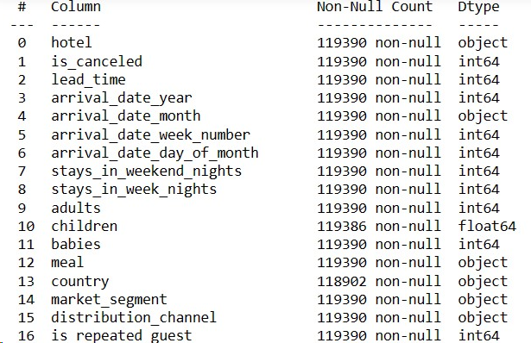
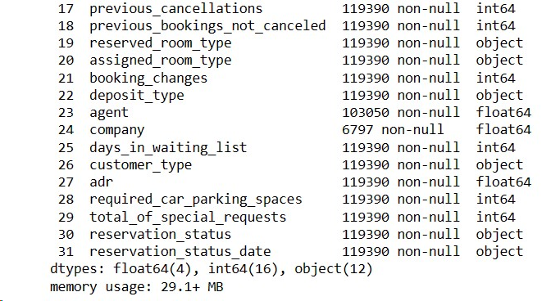
DATA DESCRIPTION

Slide 5
“is_cancelled” will be our target variable in our ML model
This binary variable indicates whether a booking was cancelled (1) or not (0). The goal of the machine learning model will be to predict this variable based on the other features in the dataset.

Slide 6
EXPLORATORY DATA ANALYSIS

Slide 7
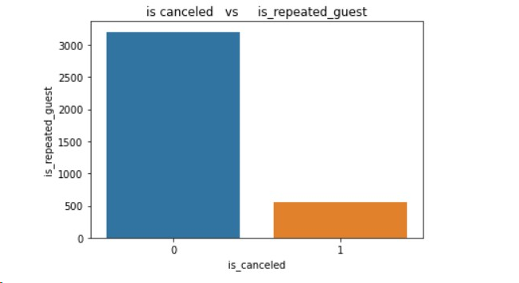
DATA VISUALIZATIONS
Bar plot using Seaborn, from this visualization we can analyze how many guests who repeated cancelled the booking

Slide 8
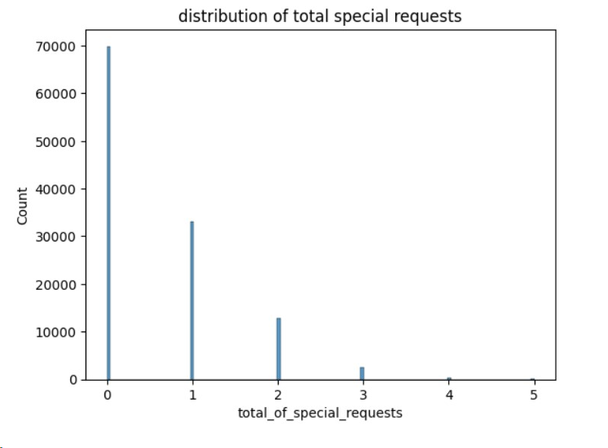
Histogram using Seaborn to visualize the distribution of ‘total_of_special_requests’ in the hotel_data.
From this visualization we can tell how many customers asked for a special request to book a hotel room and how many times they asked for special request.

Slide 9
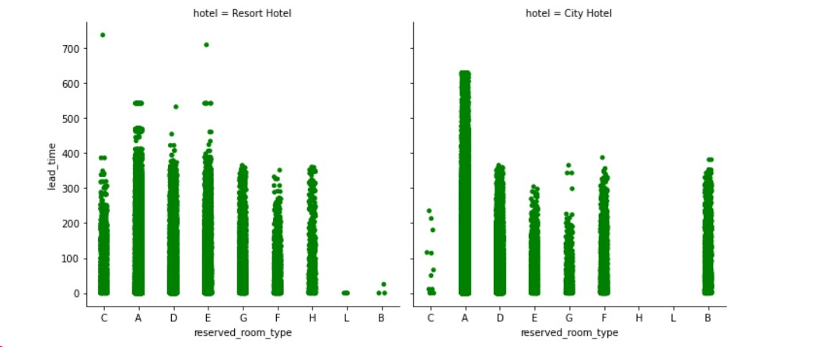

Slide 10
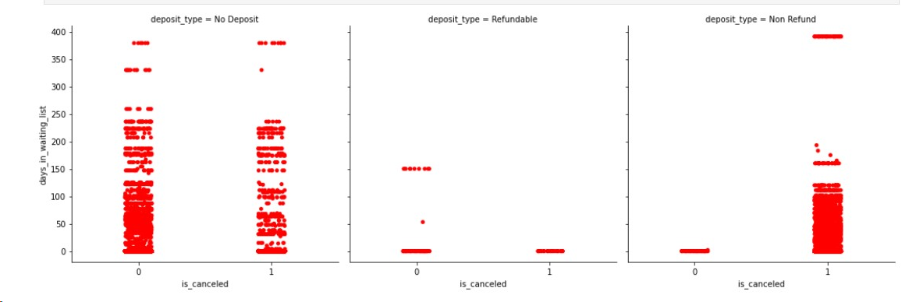

Slide 11
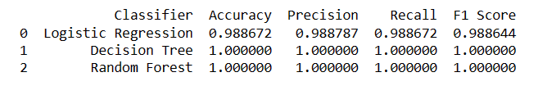
Machine Learning Models

Slide 12
CONCLUSIONS
Logistic Regression demonstrated the highest overall performance with the highest accuracy, precision, recall, and F1 score among the three classifiers.
Decision Tree exhibited slightly lower performance compared to Logistic Regression but still provided reasonable accuracy and balanced precision and recall.
Random Forest showed competitive results, balancing precision and recall, providing a good trade-off between the two.

